Slide 1
HTT splicing enhancer on-target and off-target effects (2nd data set)
Aug 26, 2022
HTT Group Meeting
Zhen, Dann, Catherine, Joon, Magnus, Jessica

Slide 2
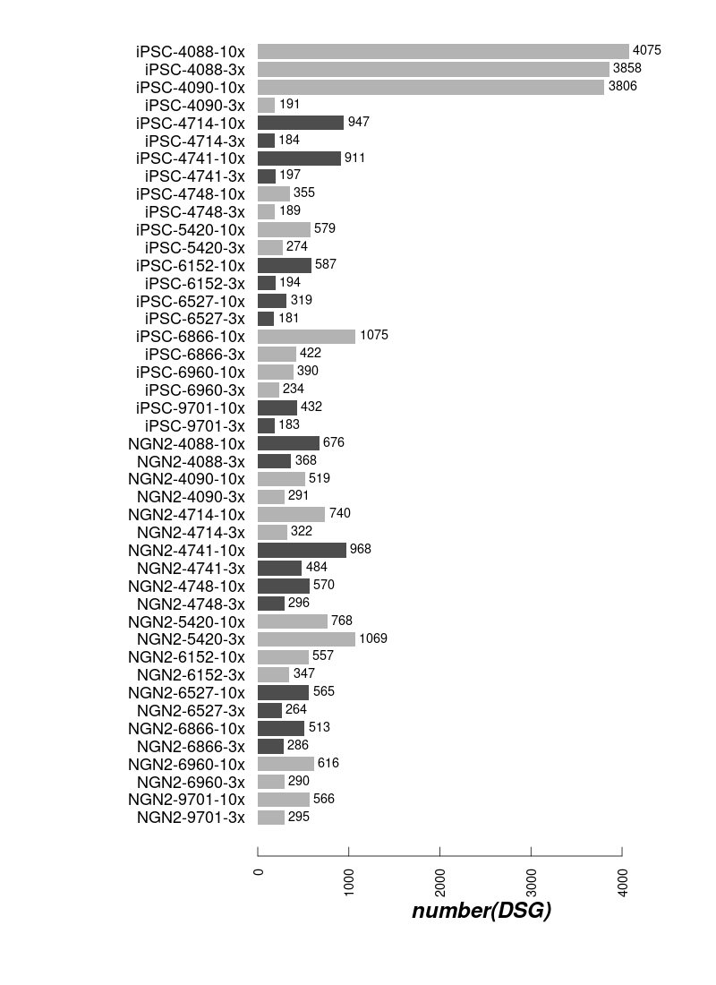
Differential spliced genes

Slide 3
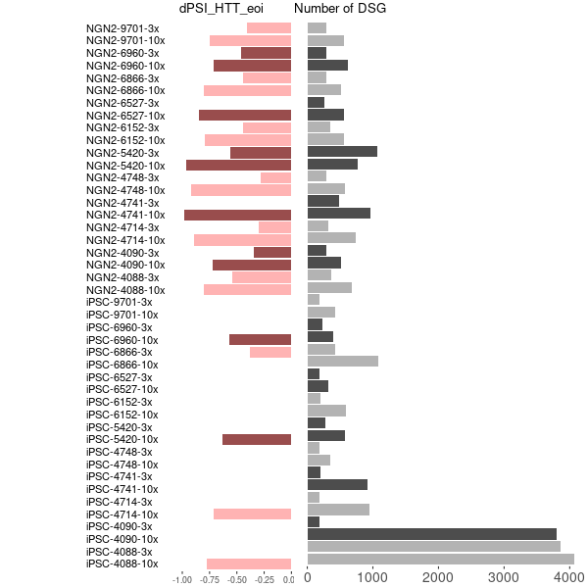
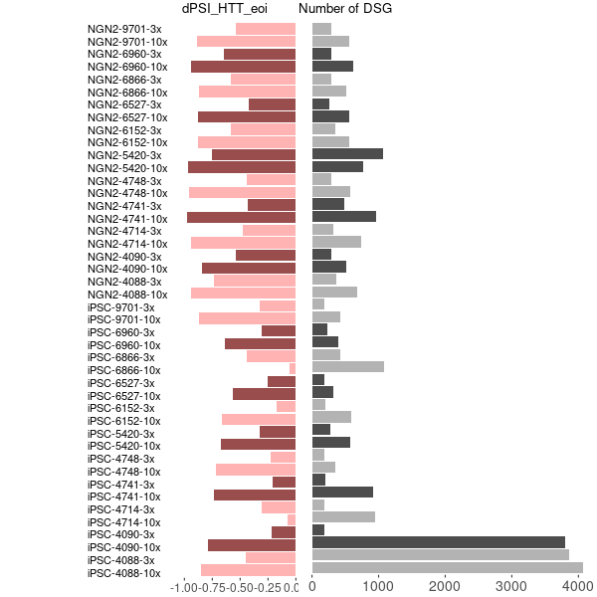

DSG and dPSI in eoi
Updated dPSI from leafcutter
dPSI from majiq
leafcutter majiq merged

Slide 4
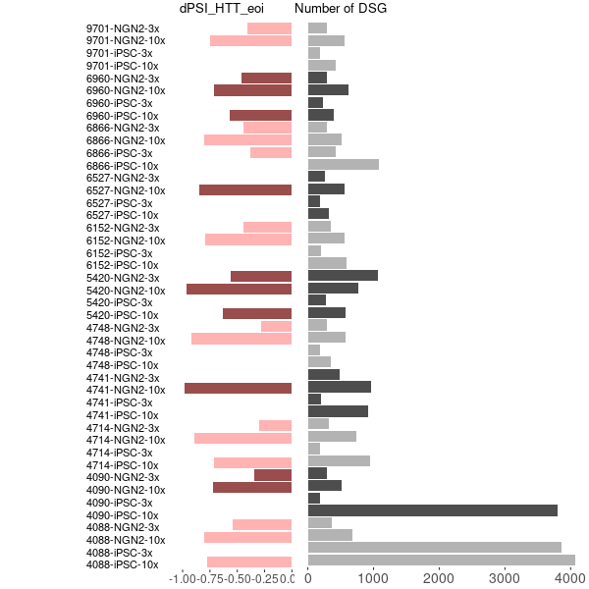
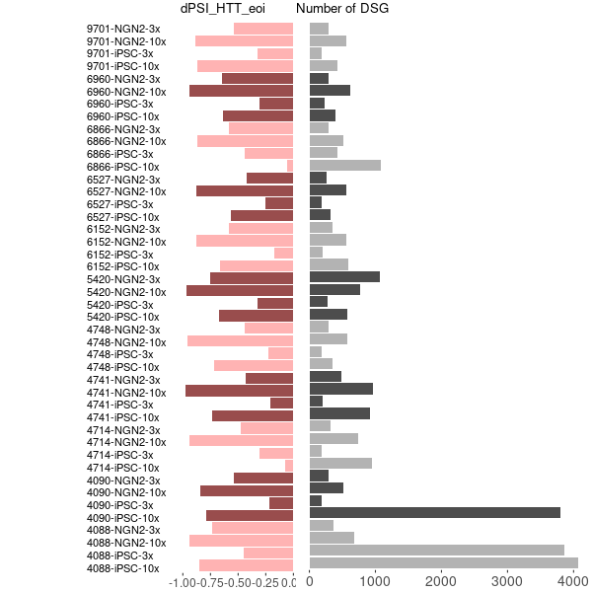
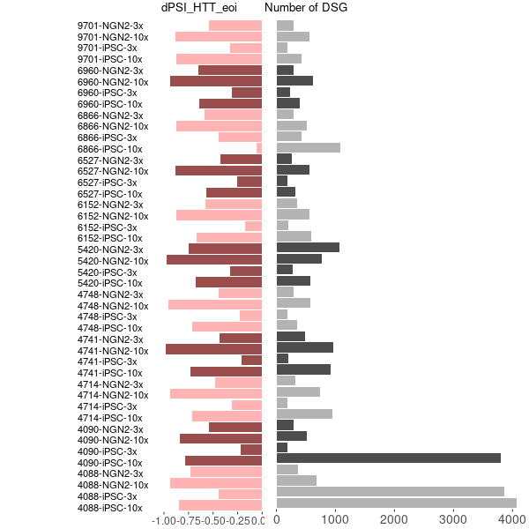
DSG and dPSI in eoi
Updated dPSI from leafcutter
dPSI from majiq
leafcutter majiq merged

Slide 5
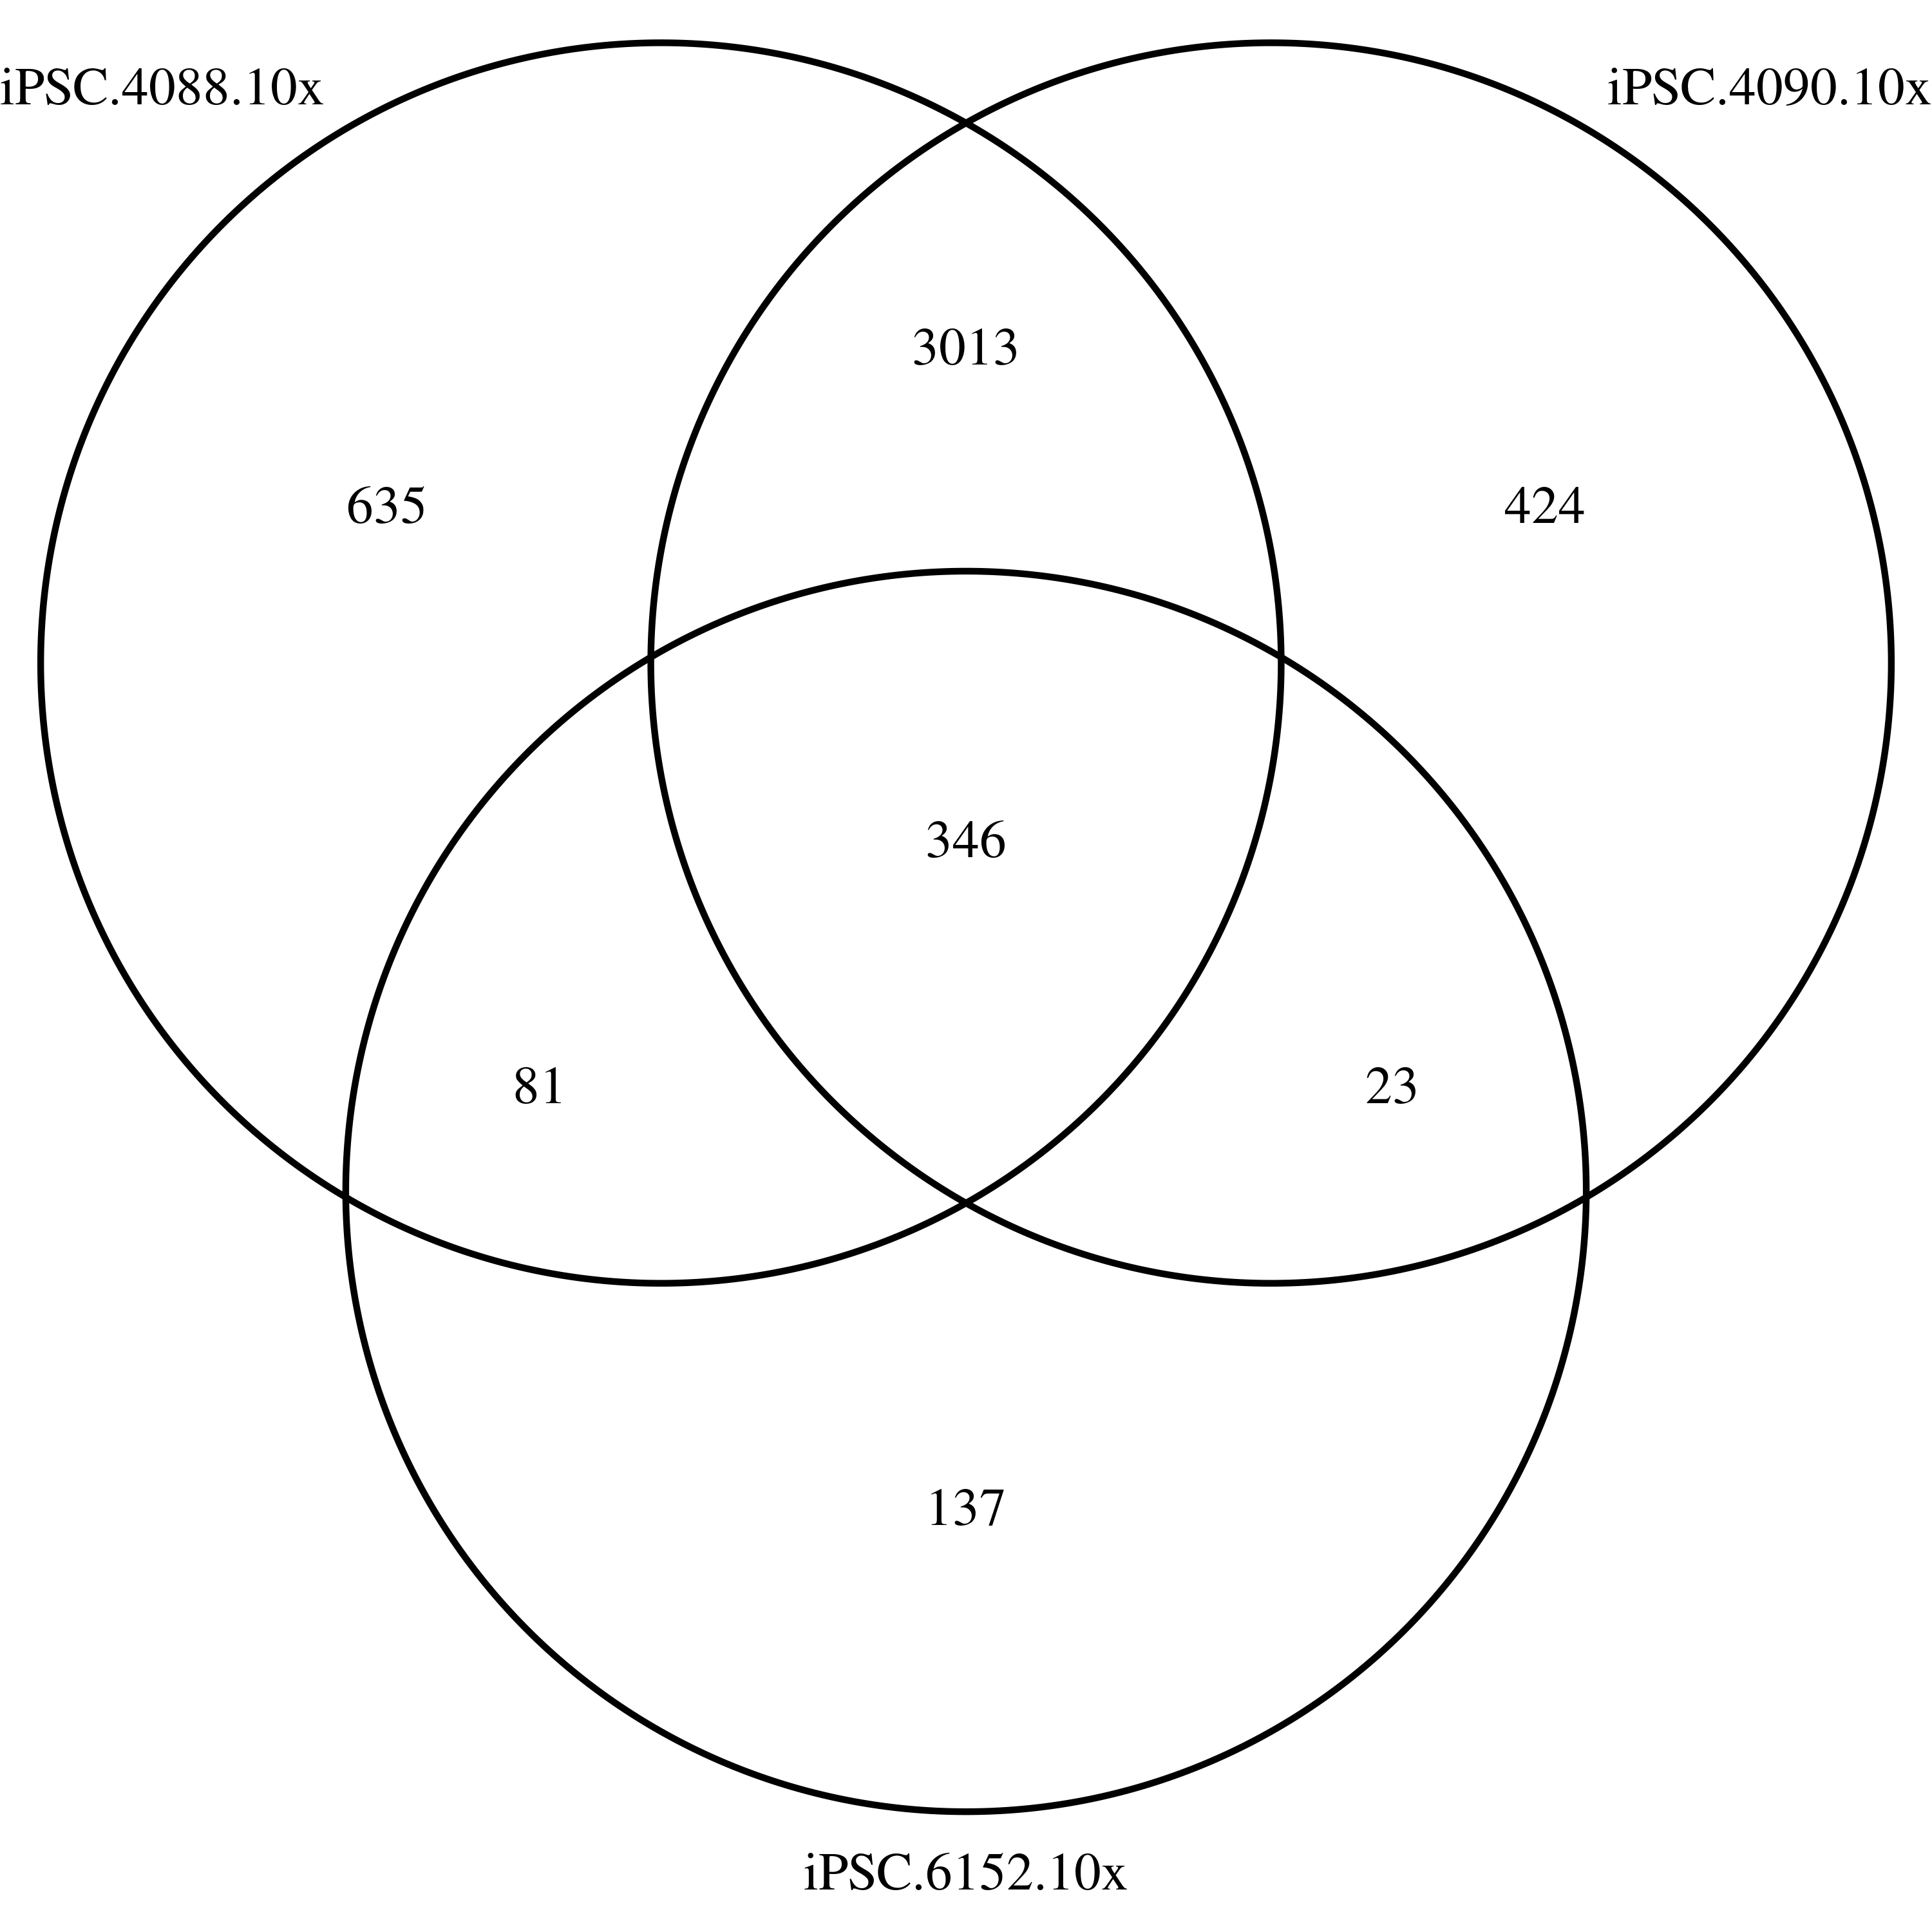
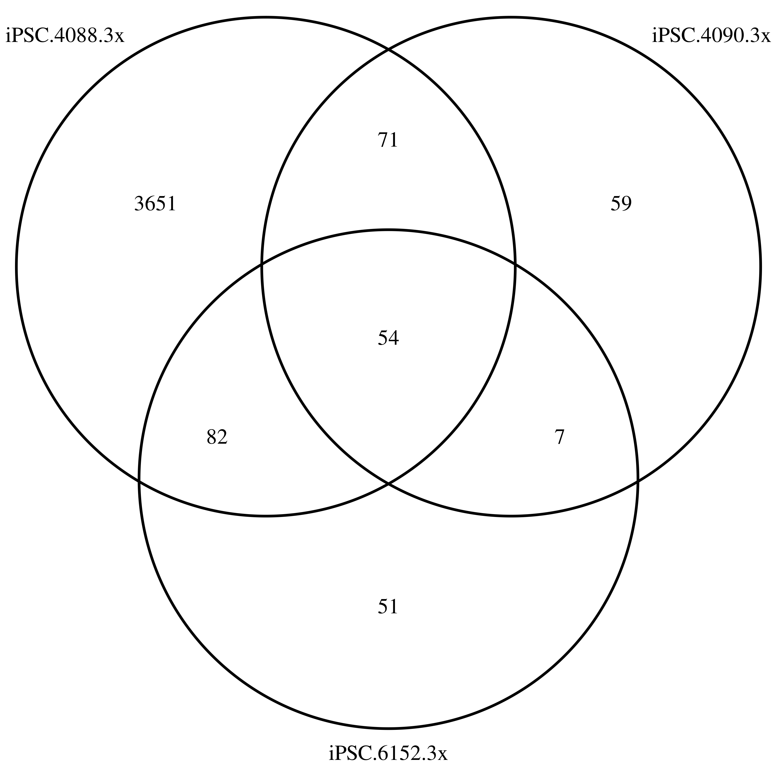
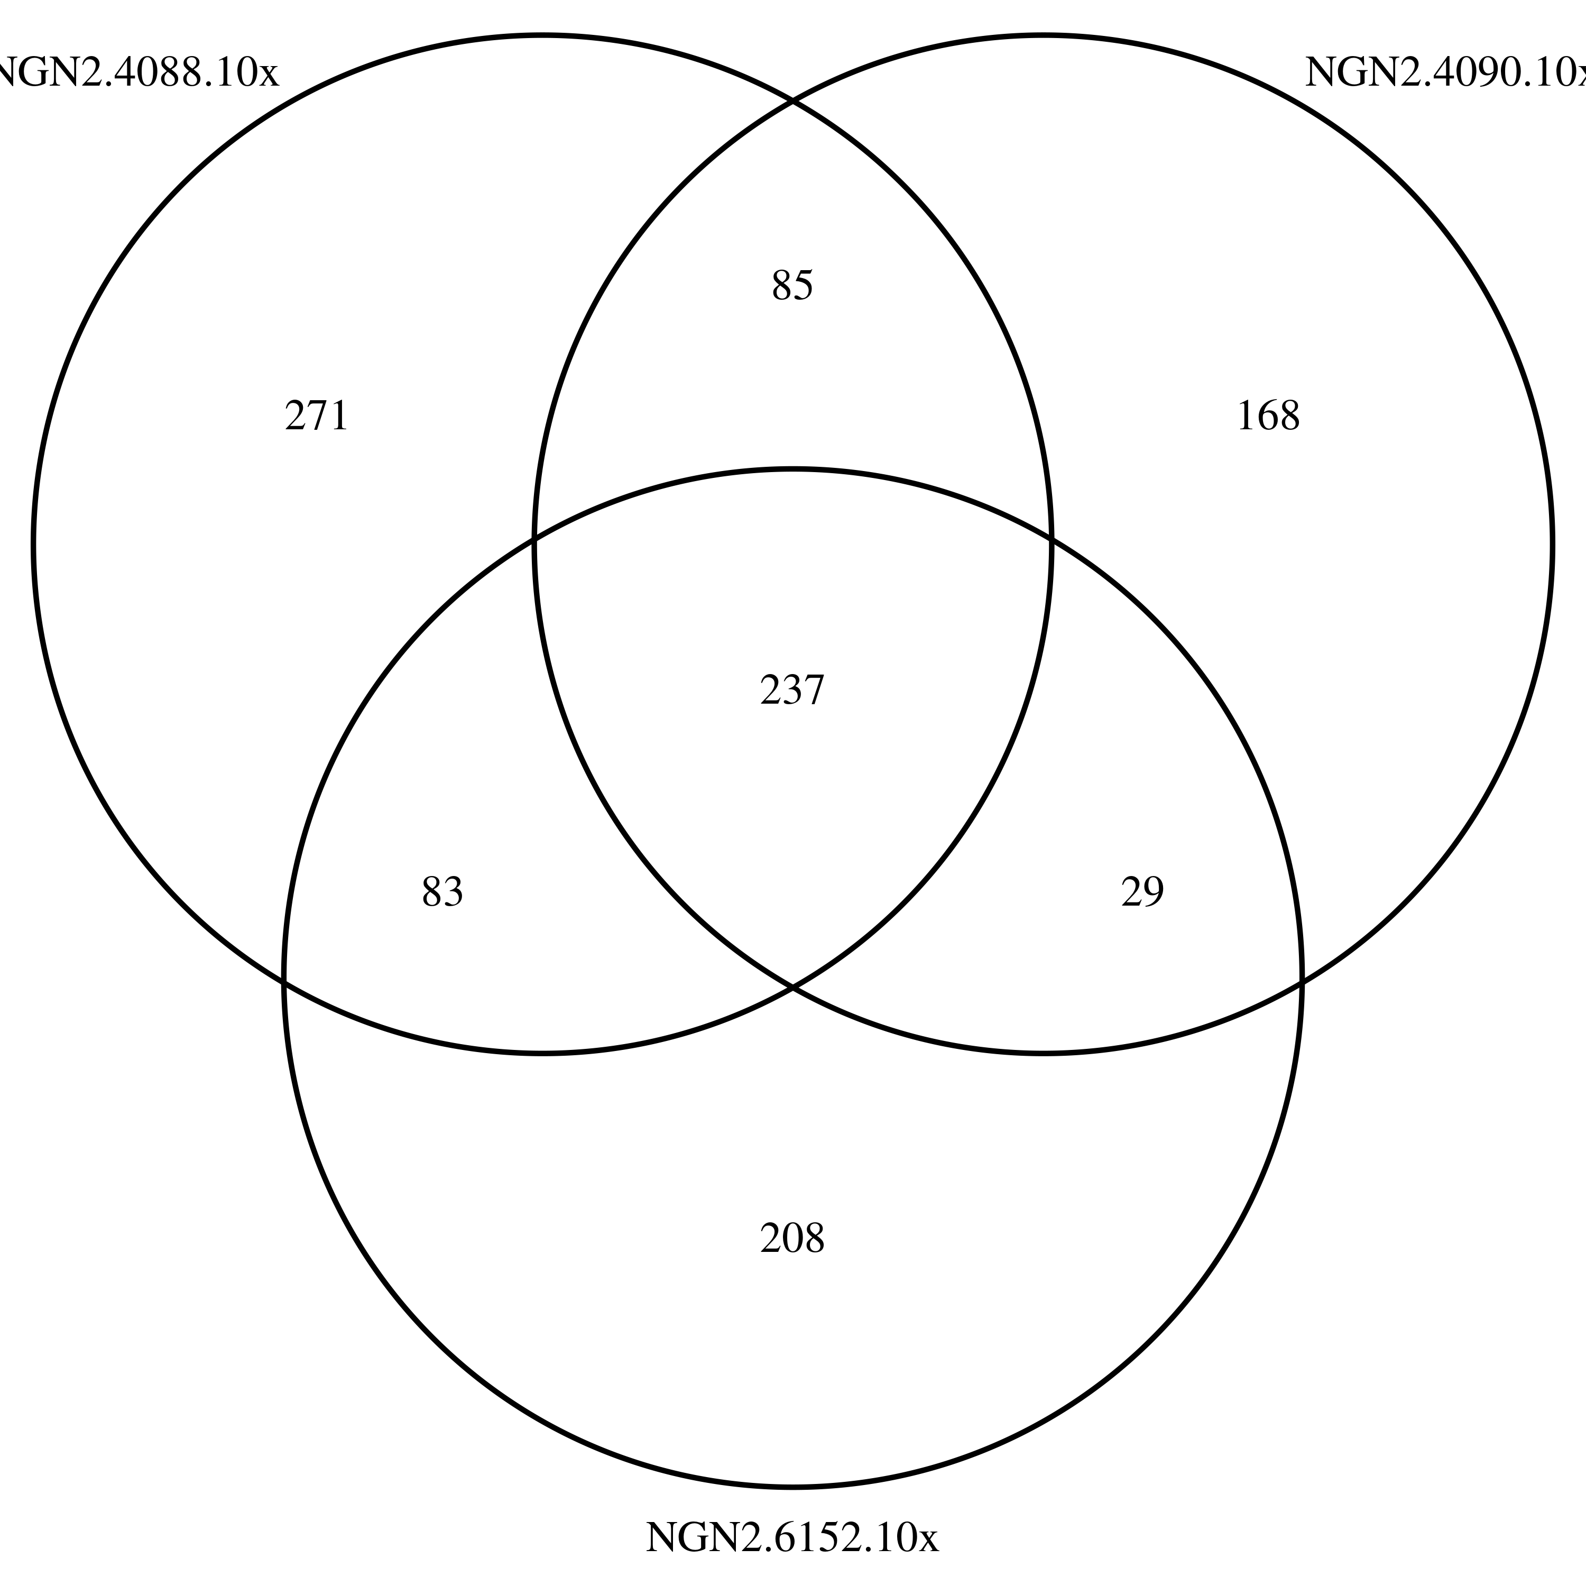
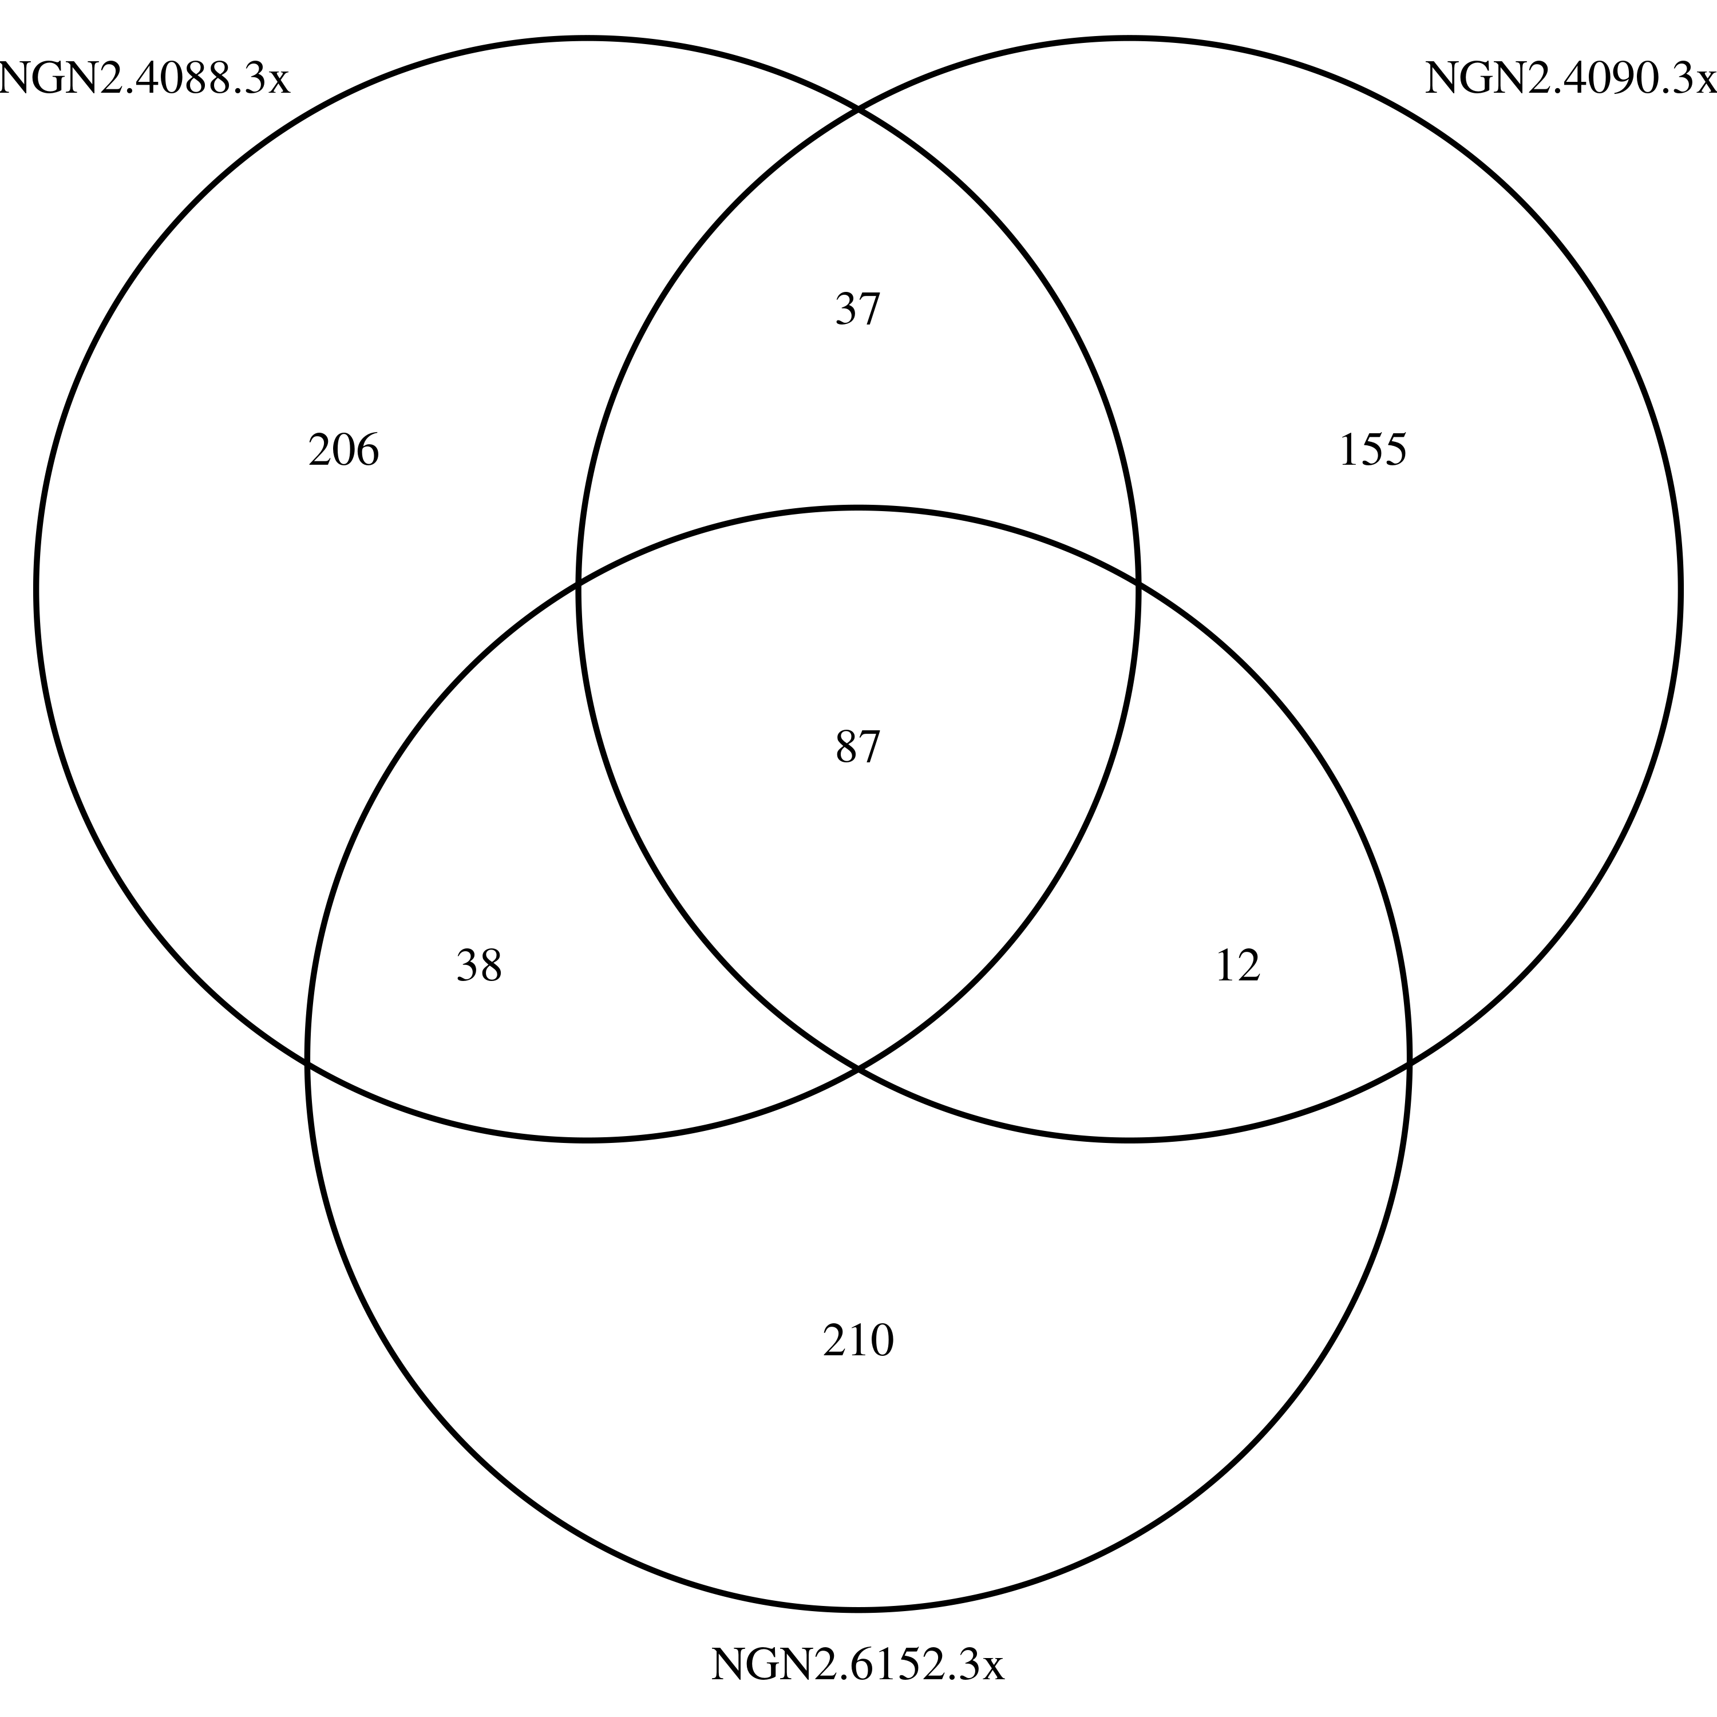
Venn

